Slide 1

QR-Code based Chipless RFID System
Anurag Marwah
anurag.marwah@nyu.edu
Net ID: am8482

Slide 2
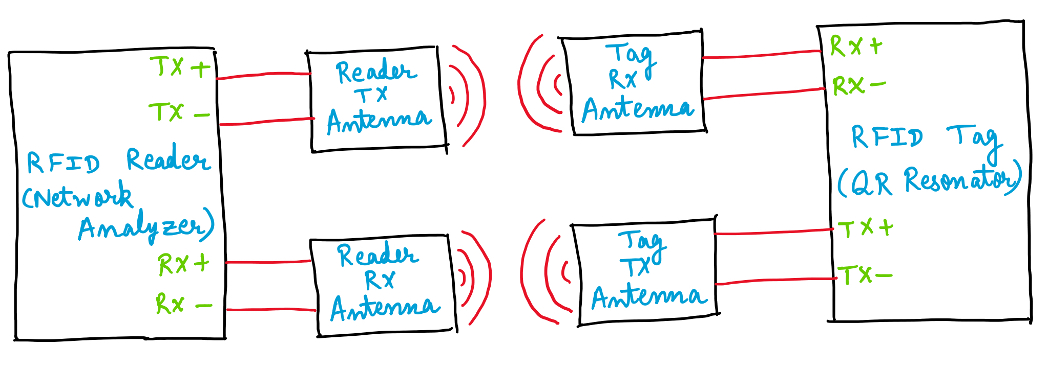
Introduction
Purpose and Background
Block Diagram
To merge two existing technologies of QR-Codes and RFID, to get more secure and unique identification.
The designed tag would be readable by both QR Code readers and RFID readers.
QR Code has been proved as an antenna which resonates at a frequency depending on its structure.
Conventional chipless RFID tags are coded with 1 or 0. Instead, a QR resonator will have unique resonating frequency for each design.
Reference Paper

Slide 3
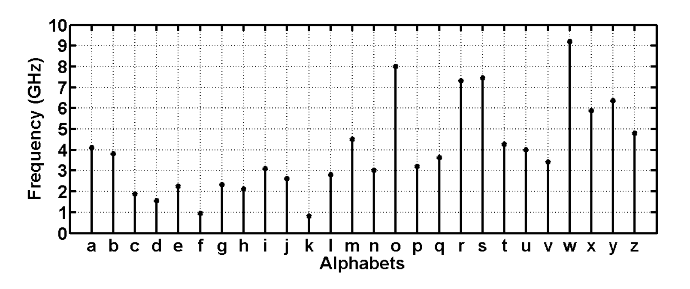
Theory and Implementation
This project involves designing and using a patch antenna as a resonator circuit
The shape of a patch is defined as a QR-code of a single alphabet letter, like C, D, F, etc.
The point of contact at the QR code affects the resonant frequency
Different QR resonators are designed and tested for S21 parameters
A monopole UWB antenna is designed and used as RFID Tag Antenna
A Log Periodic Dipole Antenna is designed and used as RFID Reader Antenna
Expected Frequencies of QR Resonators

Slide 4
Part List
S. No. | Circuit | Parts Required | Unit Cost | Quantity | Total Cost | Link
1 | QR Resonator | PCB (Single-sided milling) | $- | 1 | $-
 |  | SMA Connectors | $2.84 | 2 | $5.68 | Link
2 | Tag Antenna | PCB (Double-sided milling): TX and RX | $10.25 | 1 | $10.25 | Link
 |  | SMA Connectors | $2.84 | 2 | $5.68 | Link
 |  | Male to Male SMA Connector | $6.74 | 1 | $6.74 | Link
 |  | 90-degree Male to Male SMA Connector | $9.50 | 1 | $9.50 | Link
3 | Reader Antenna | PCB (Double-sided milling): TX and RX | $48.70 | 1 | $48.70 | Link
 |  | SMA Connectors | $2.84 | 2 | $5.68 | Link
4 | QR Resonator 2 (For Testing) | PCB (Single-sided milling) | $- | 1 | $- | Link
 |  | SMA Connectors | $2.84 | 2 | $5.68 | Link
5 | QR Resonator 3 (For Testing) | PCB (Single-sided milling) | $- | 1 | $- | Link
 |  | SMA Connectors | $2.84 | 2 | $5.68 | Link
Total Cost | $103.59

Slide 5
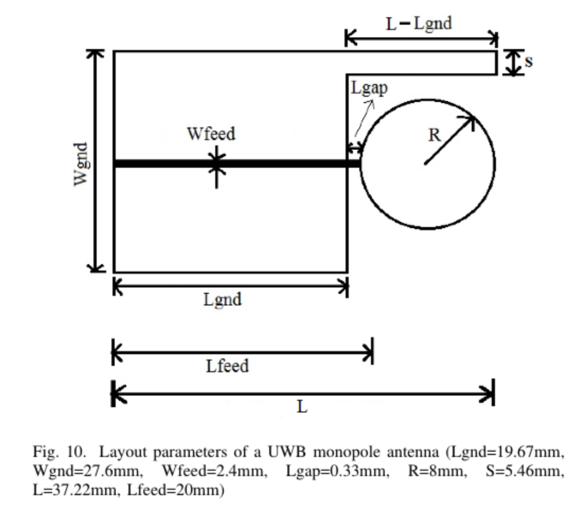
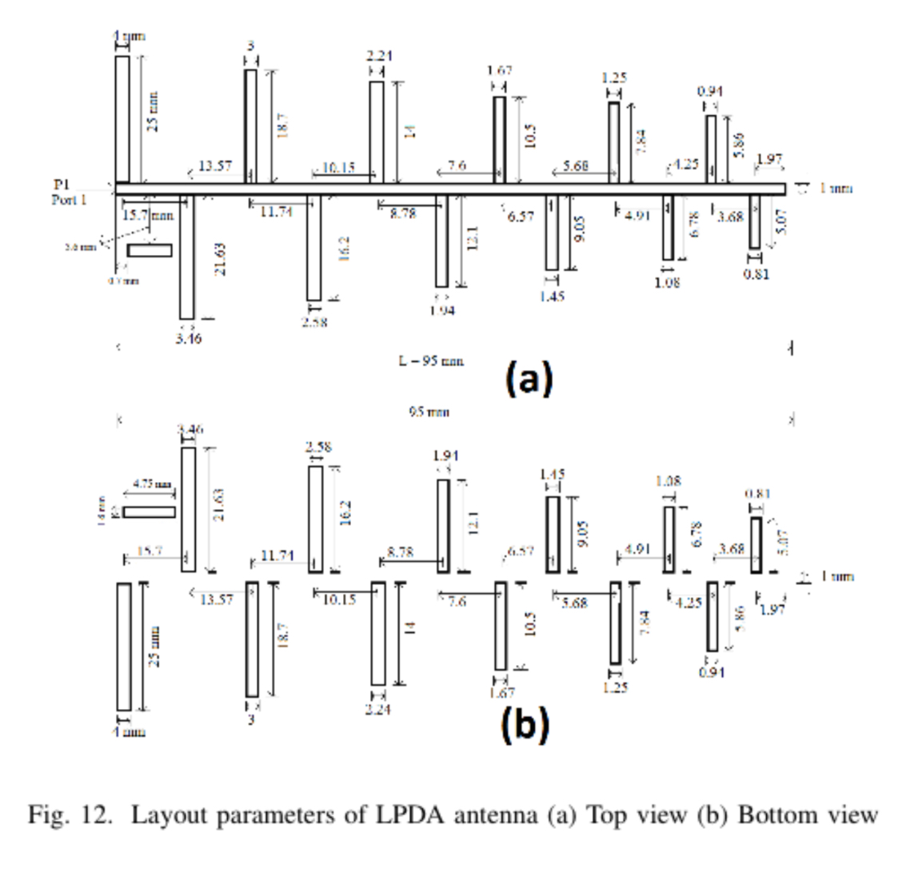
Schematics for Antenna Modules
Ultra wide band RFID Tag Antenna
(Monopole Disc Loaded Antenna)
Ultra wide band RFID Reader Antenna
(Log Periodic Dipole Antenna)

Slide 6
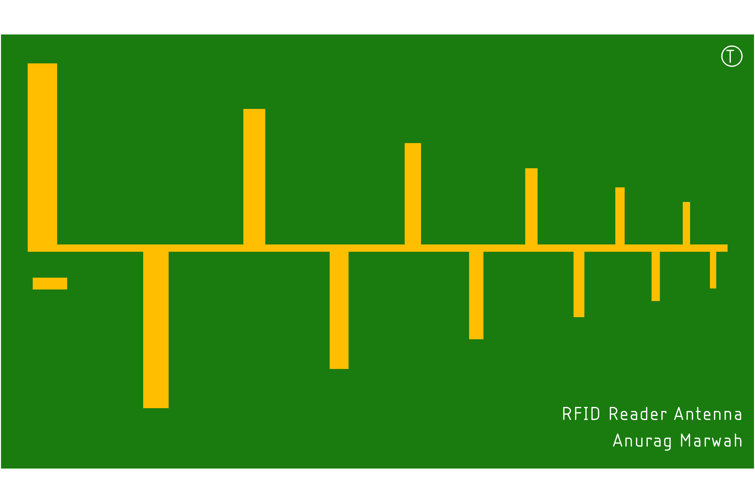


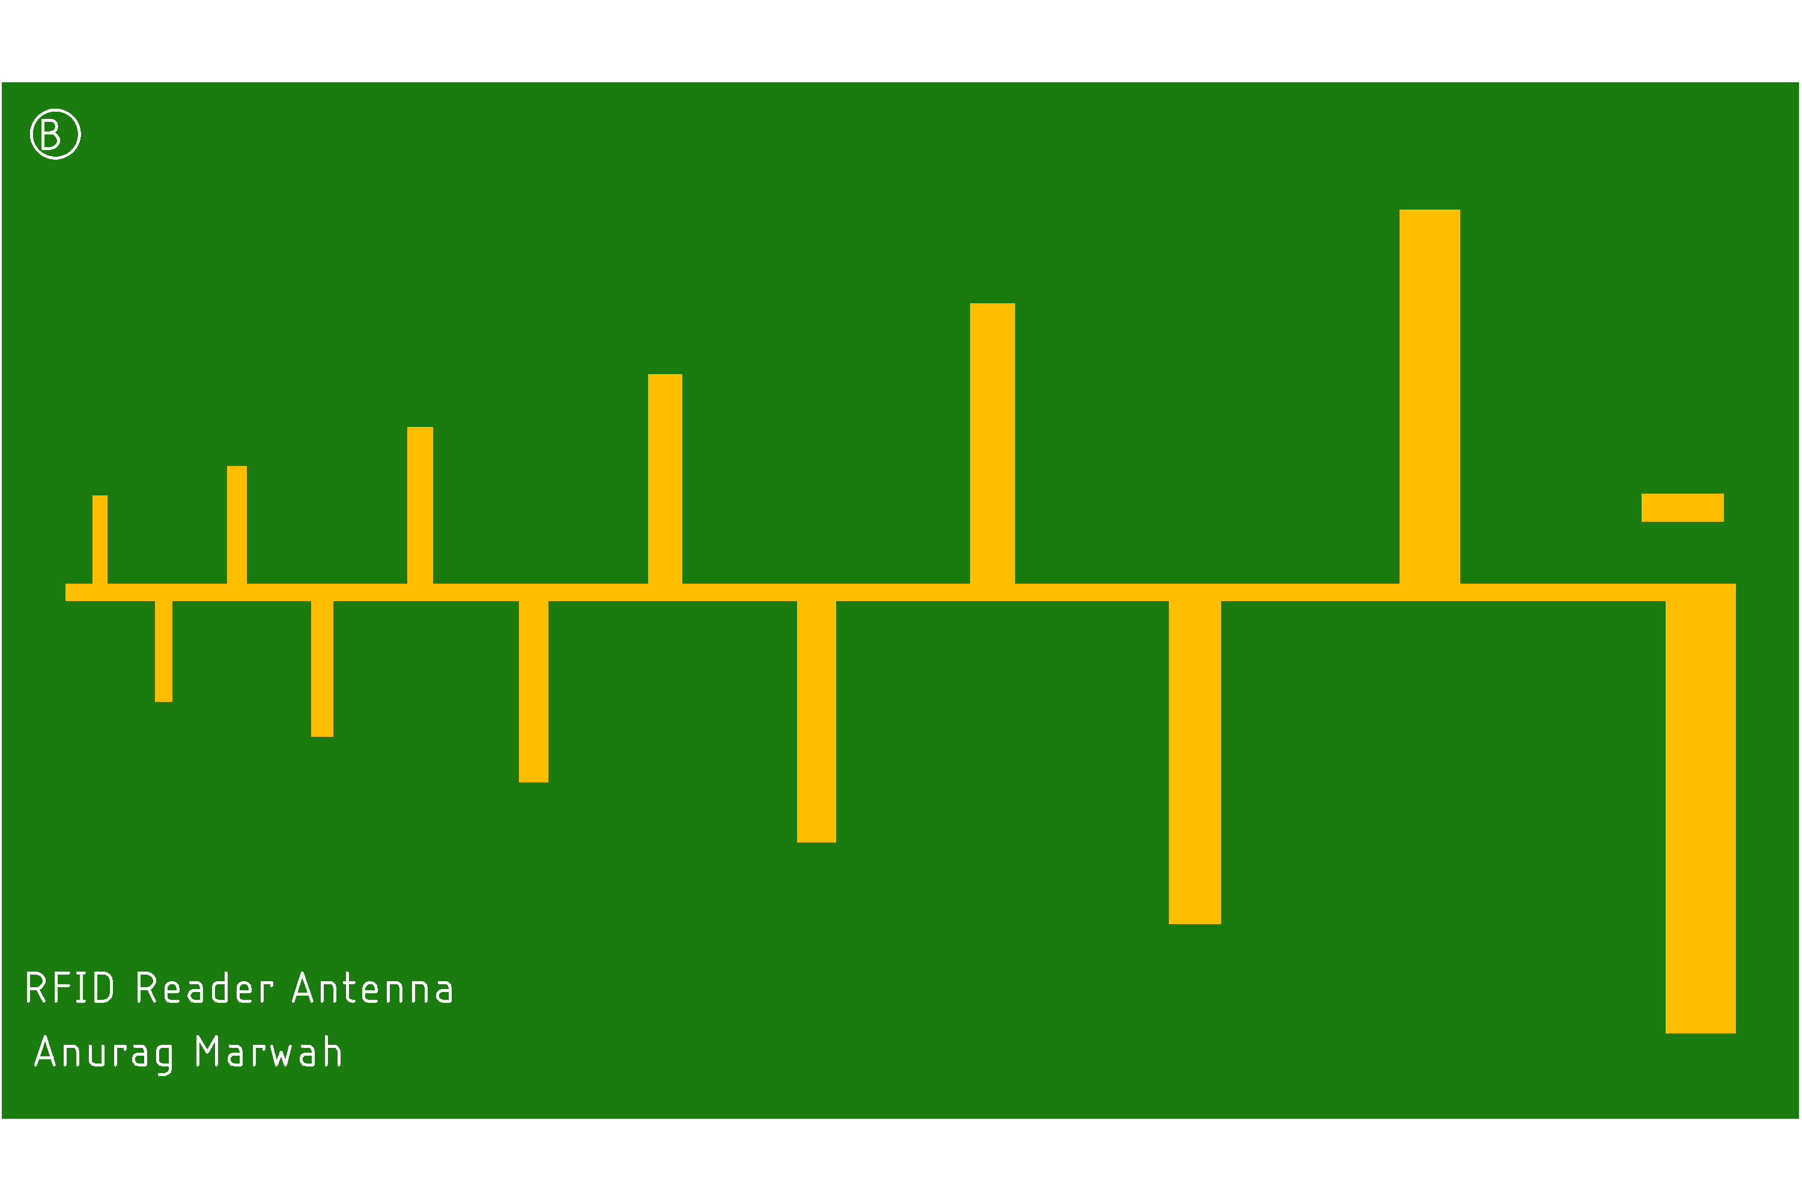



Circuit Layouts
QR Resonator - D
QR Resonator - C
QR Resonator - F
RFID Tag Antenna
RFID Reader Antenna

Slide 7
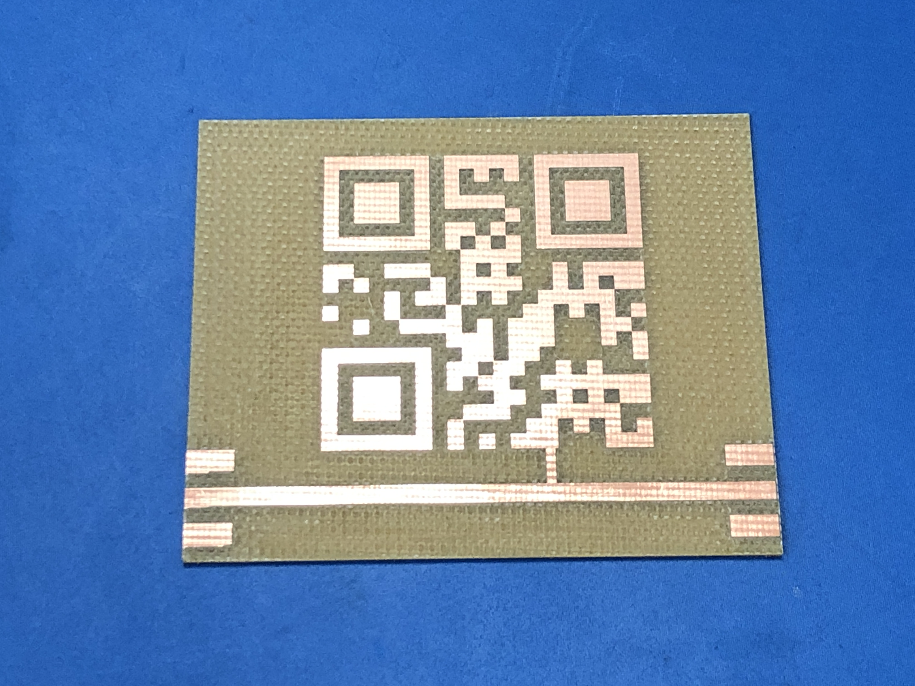
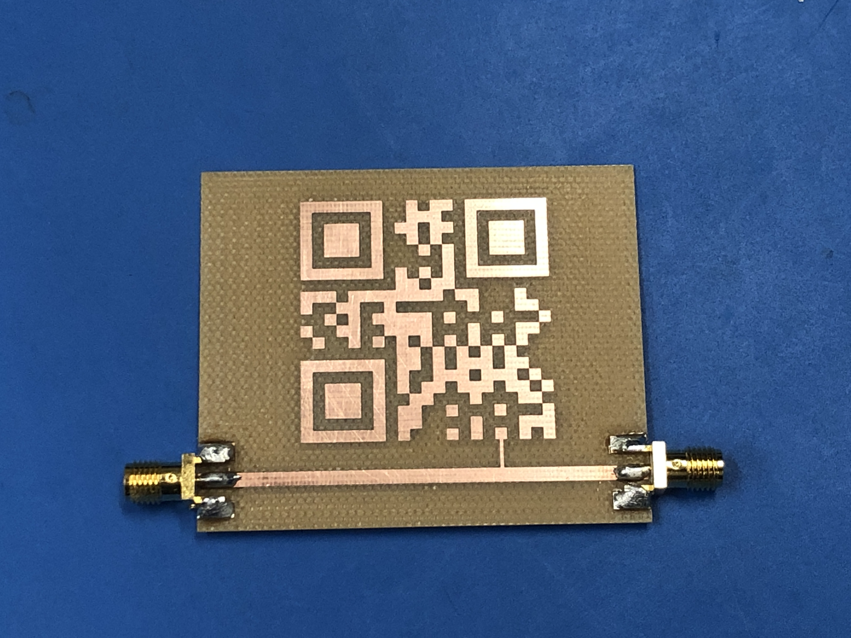
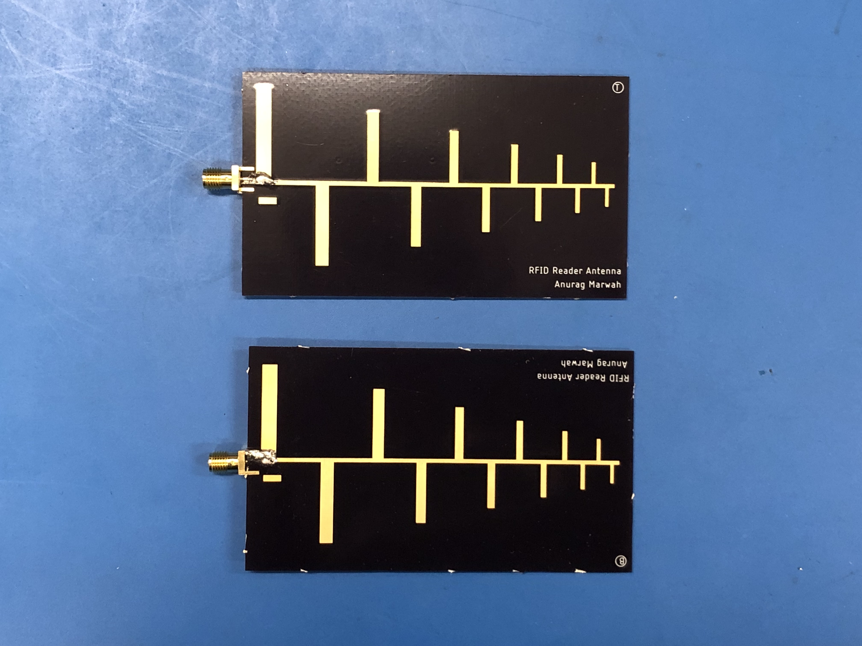
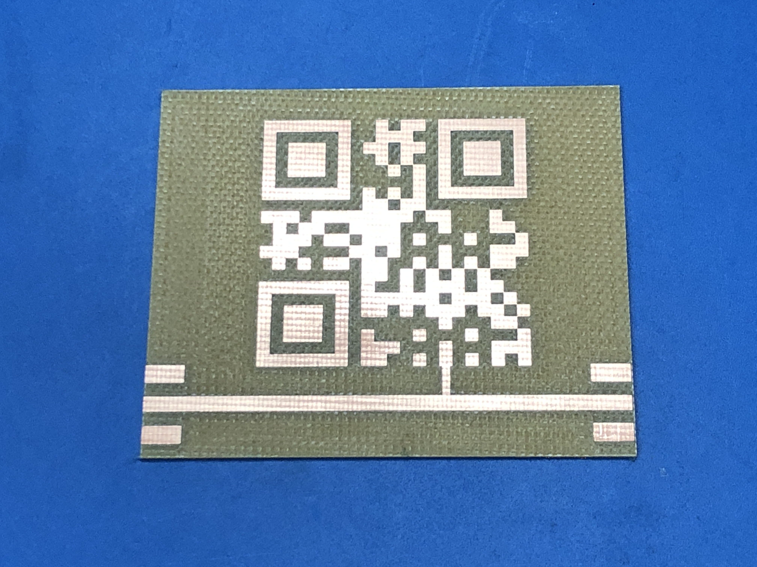
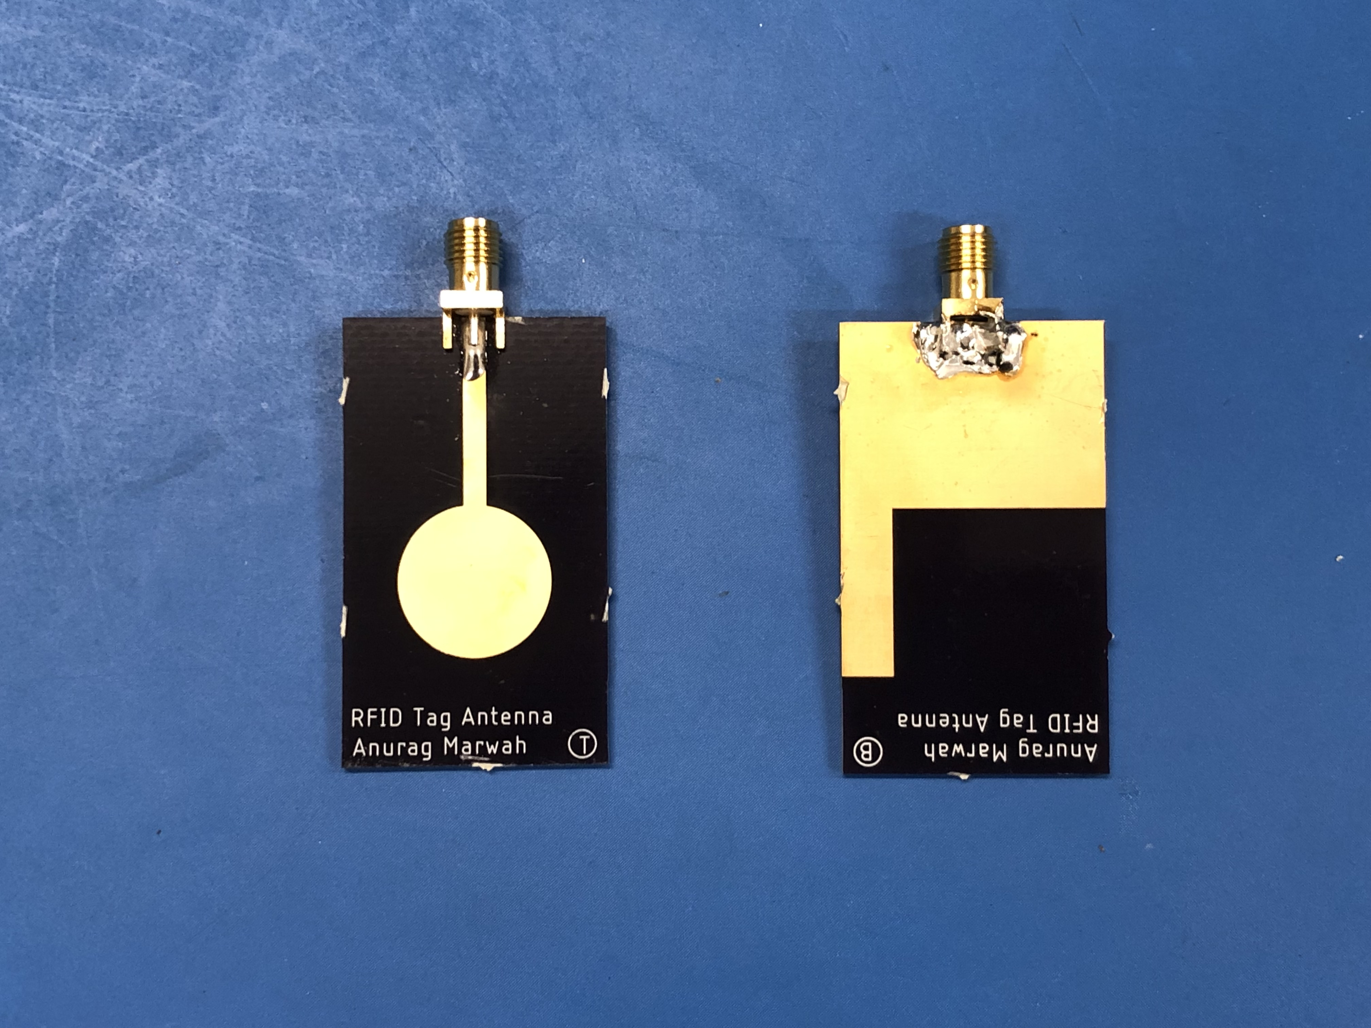
PCBs
QR Resonator - D
QR Resonator - C
QR Resonator - F
RFID Tag Antenna
RFID Reader Antenna

Slide 8
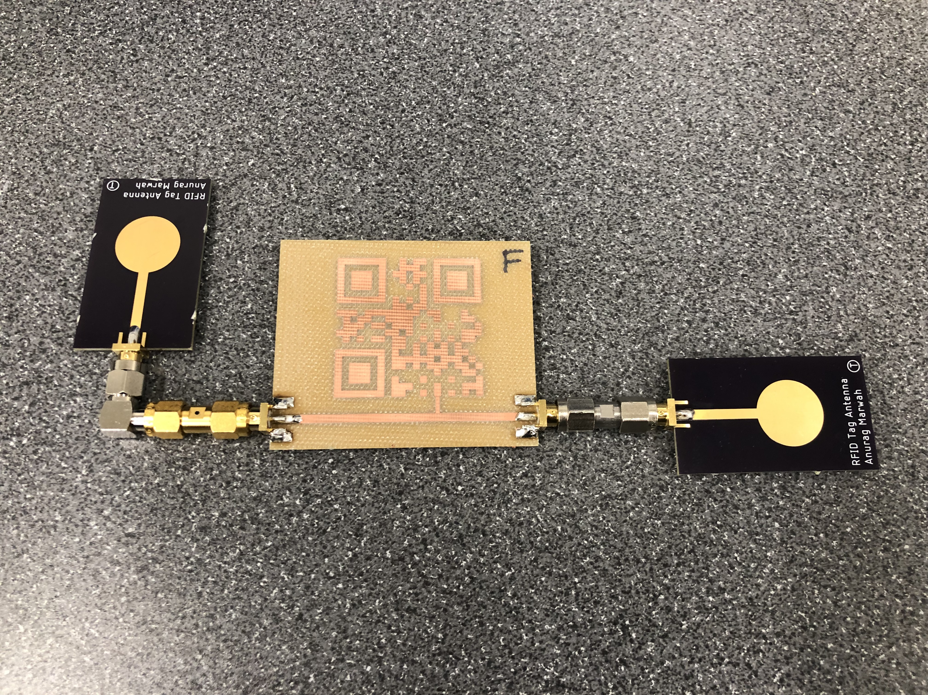
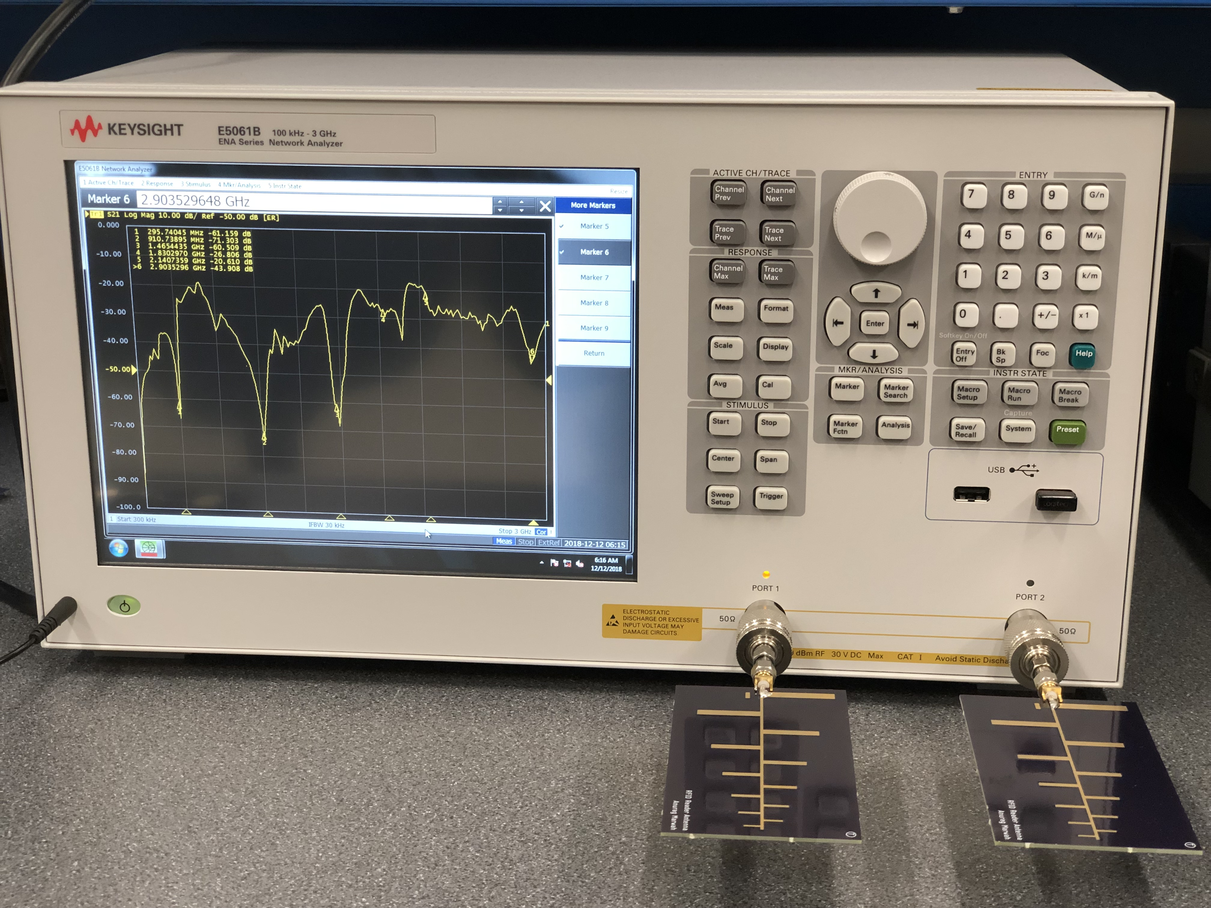
Experimental Setup
RFID Tag
RFID Reader

Slide 9
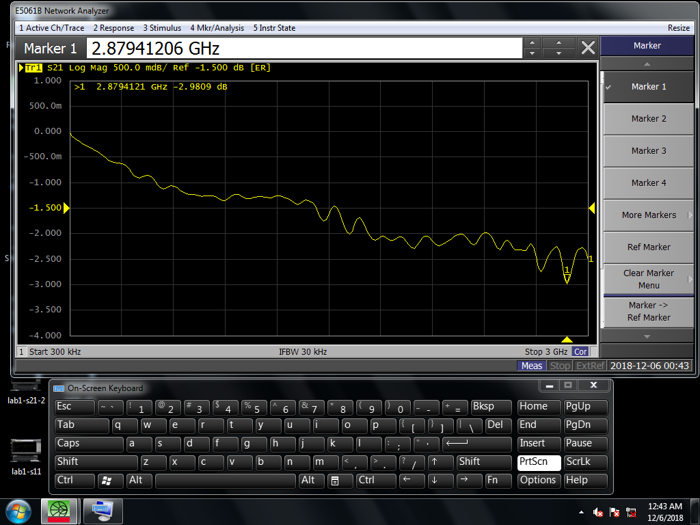
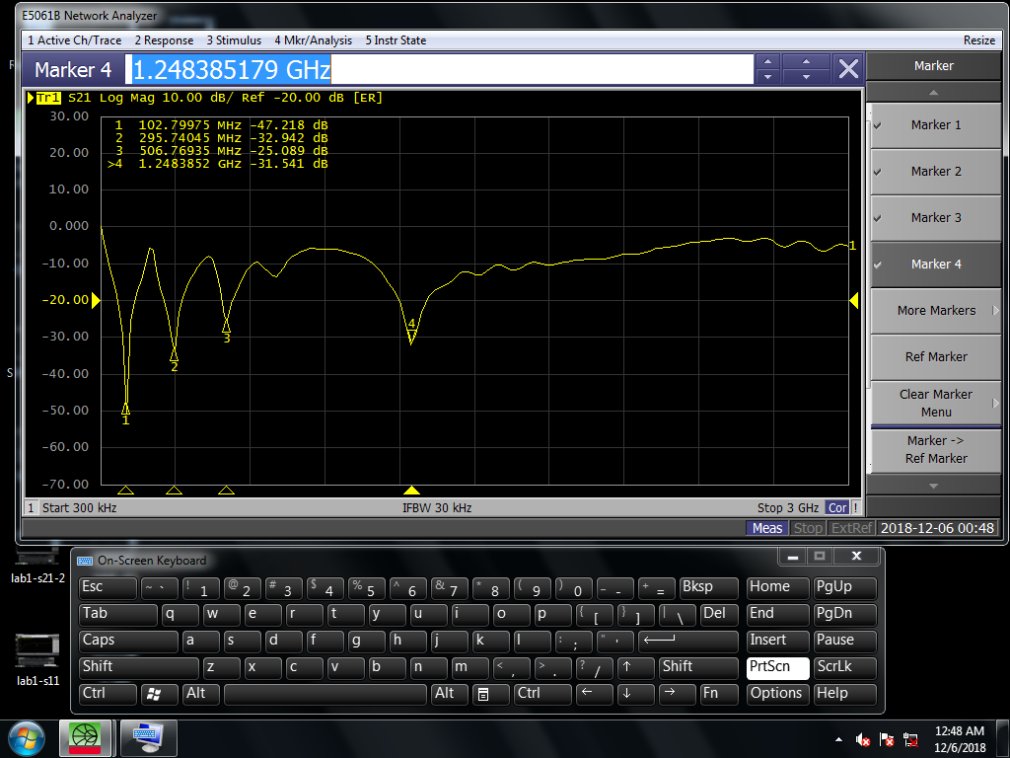
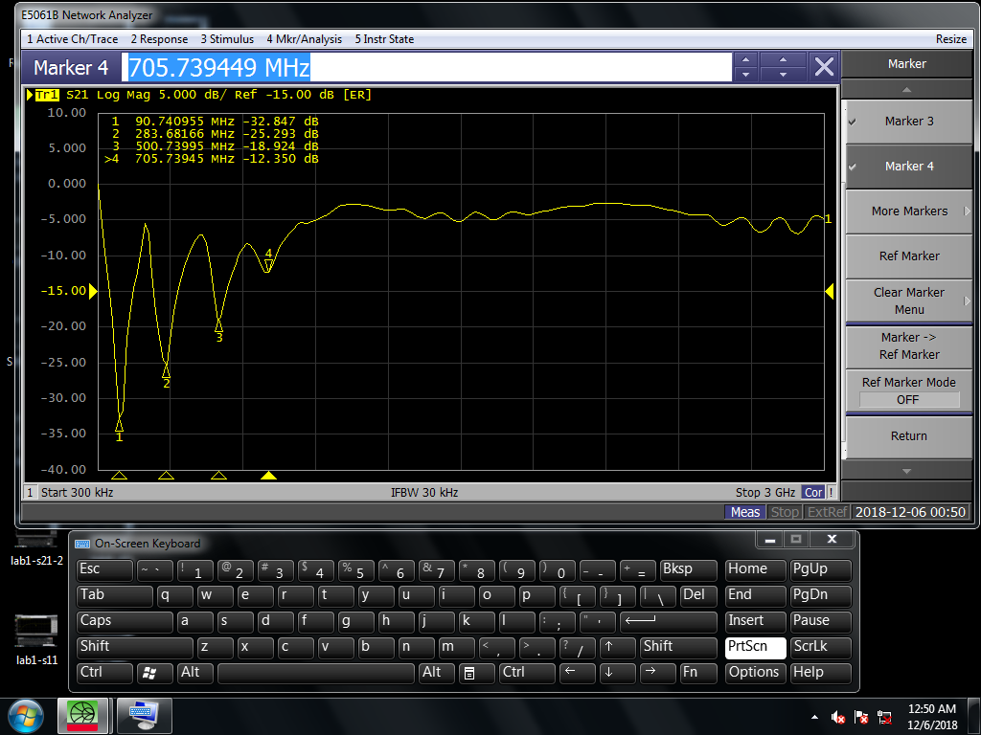
S21 Parameters of QR Resonators
QR Resonator - C
QR Resonator - D
QR Resonator - F

Slide 10
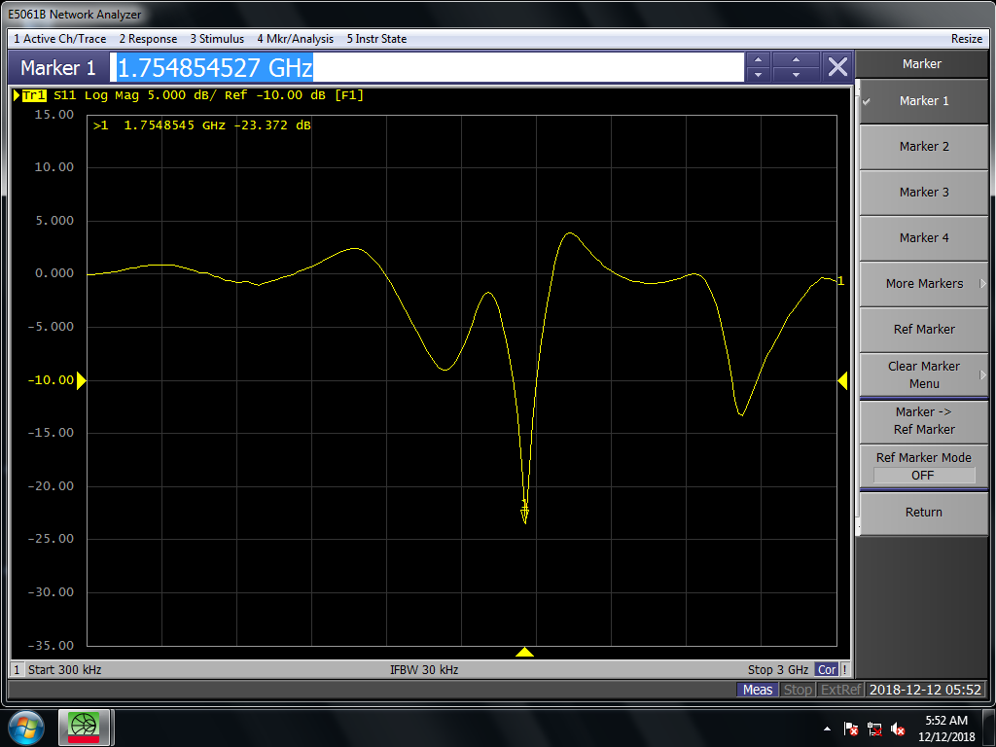
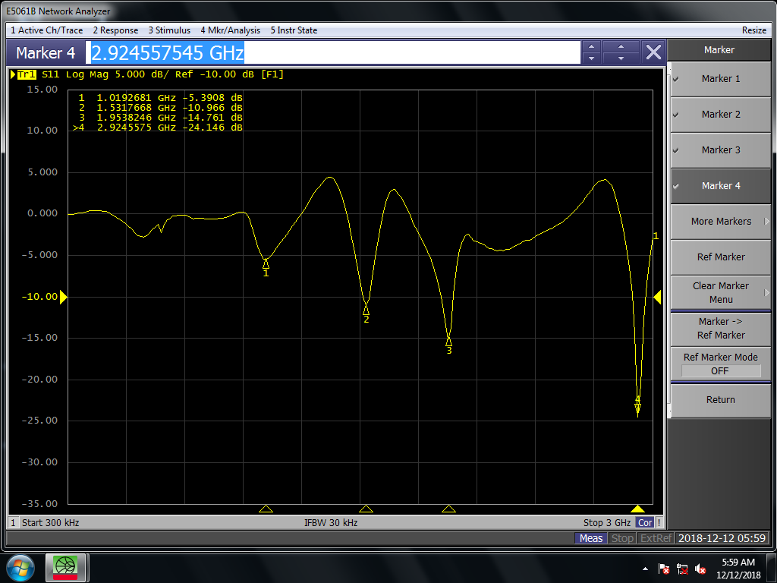
S11 Parameters of Antennas
RFID Tag Antenna
RFID Reader Antenna

Slide 11
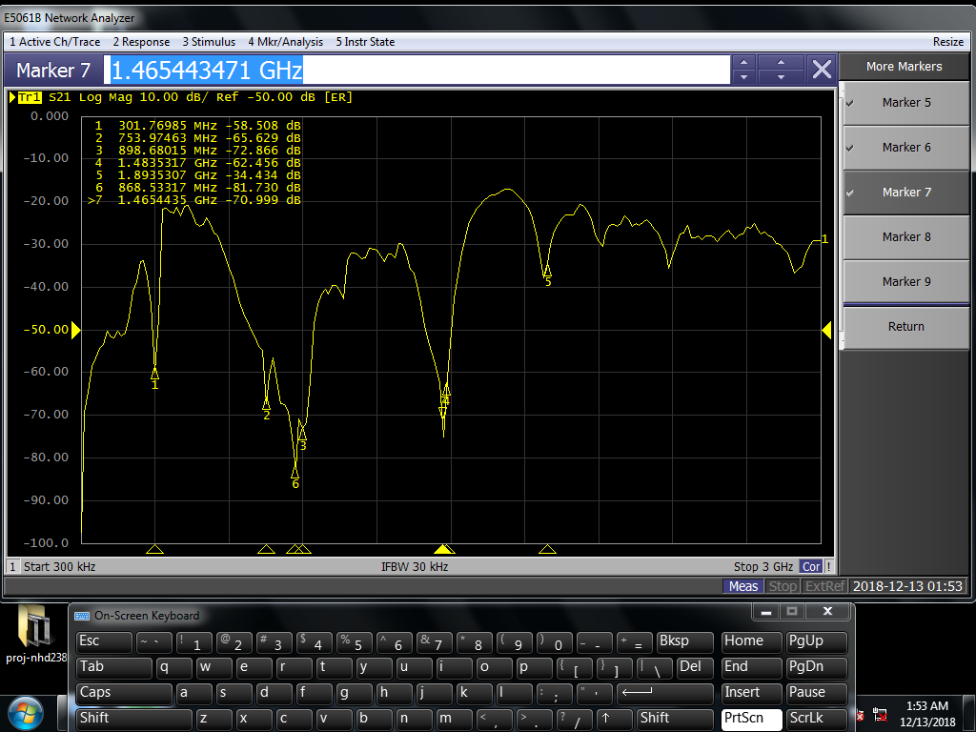
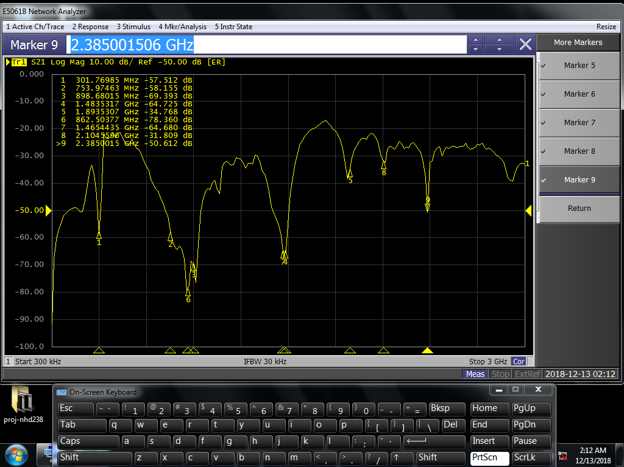
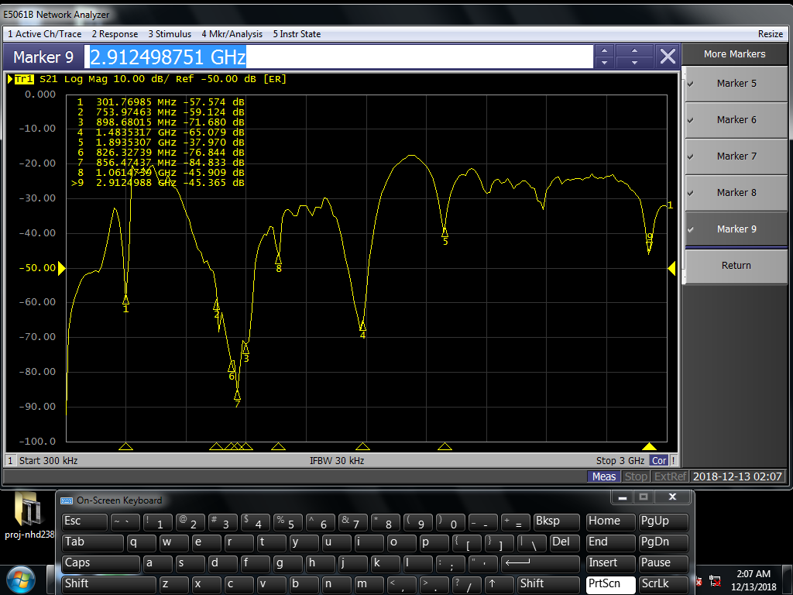
S21 Parameters of Complete Setup with different QR Resonators
QR Resonator - C
QR Resonator - D
QR Resonator - F

Slide 12
Thank you!

